Slide 1
COVID-19:
Which Factors Impact Mortality?
By Nick Wawee, Connor MacMillan, Kshitij Saxena, & Grant Ferrell

Slide 2
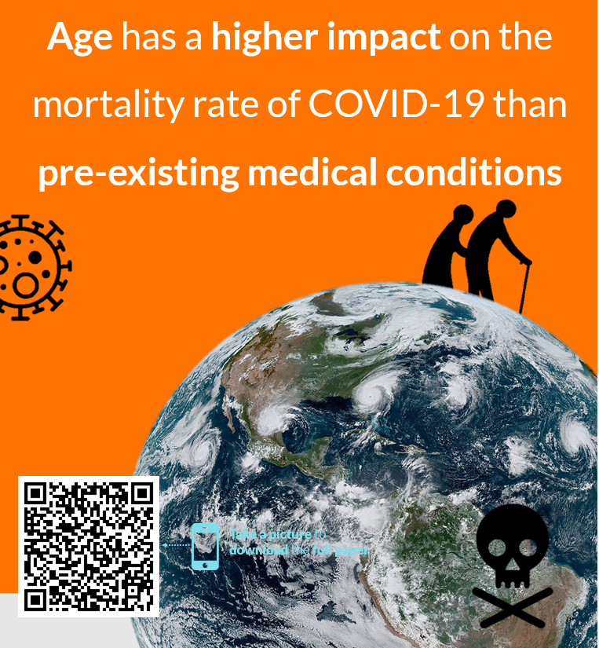
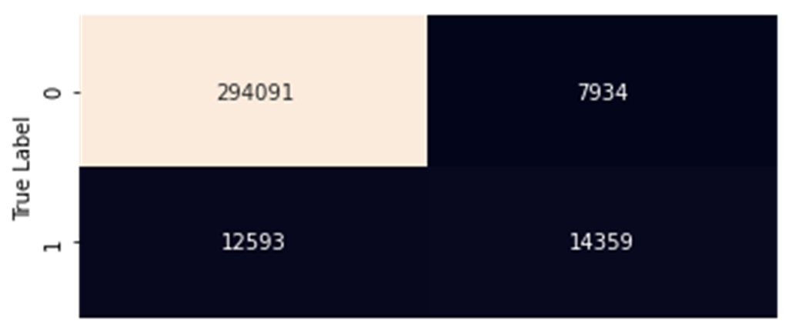

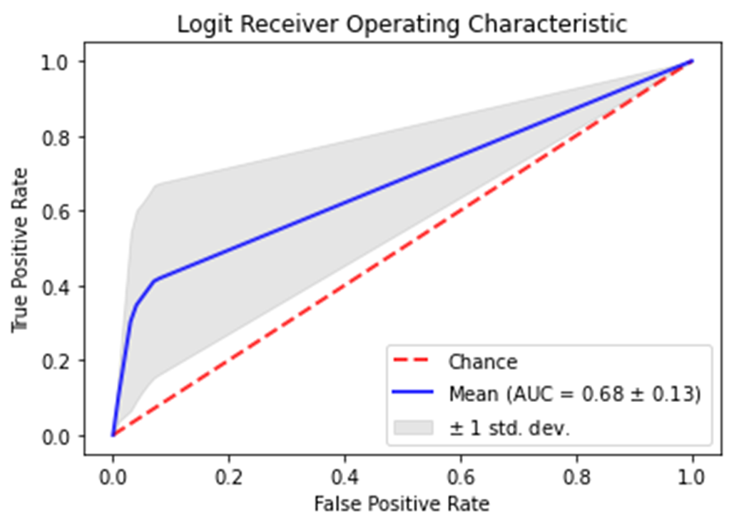
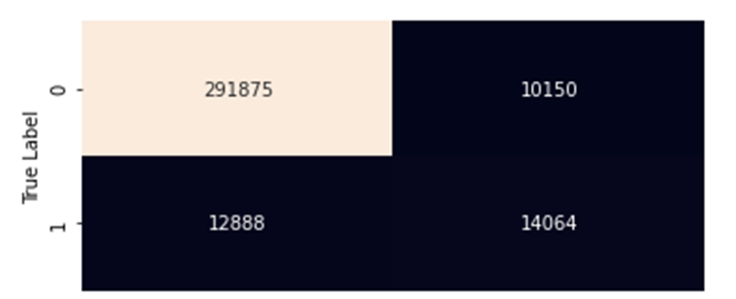

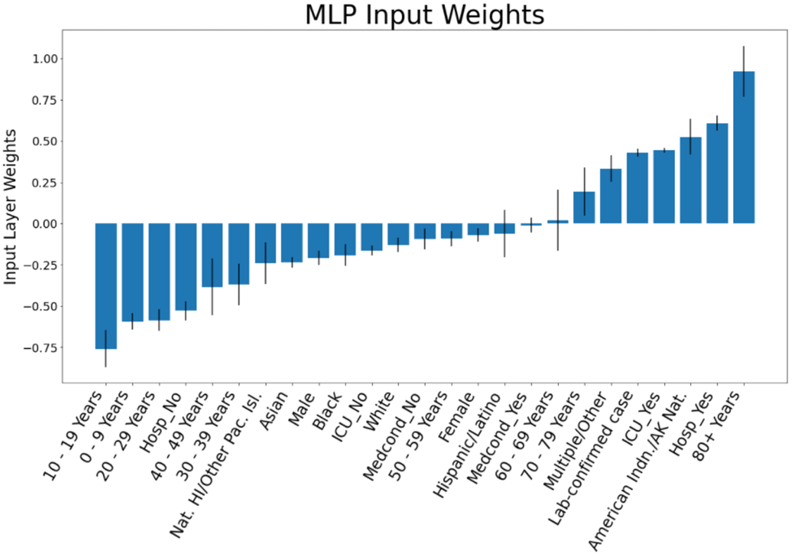
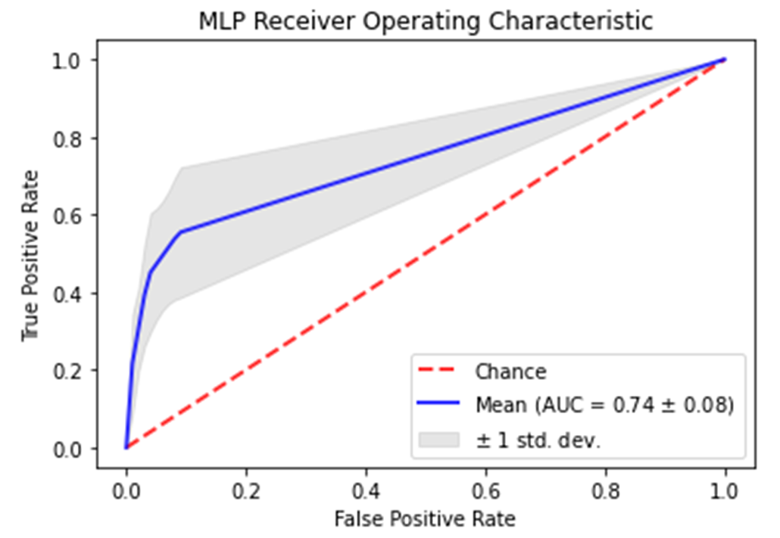

COVID-19:
Which Factors Impact Mortality?
Nick Wawee, Connor MacMillan,
Kshitij Saxena, Grant Ferrell
INTRO
COVID-19 is a deadly pandemic. Which demographic factors increase that deadliness
Factors that increase mortality should show up in fatal cases
METHODS
Use the CDC Public Use data
Focus only on relevant inputs. Final data shape: (328,977 x 8)
Find correlations
Use Logistic Regression with 5 K-Folds.
Use GridSearchCV and MLPClassifier with 5 K-Folds
Compare each model’s metrics
Use weights and coefficients to find each feature’s impact
RESULTS
DISCUSSION
Both models performed similarly, but the MLP was more consistent. The closer the weight is to 0, the less important to mortality it is. Being 80+ has the highest impact, and some races/ethnicities are more vulnerable.
Combined Confusion Matrix
0 1
Predicted Label
Combined Confusion Matrix
0 1
Predicted Label

Slide 3
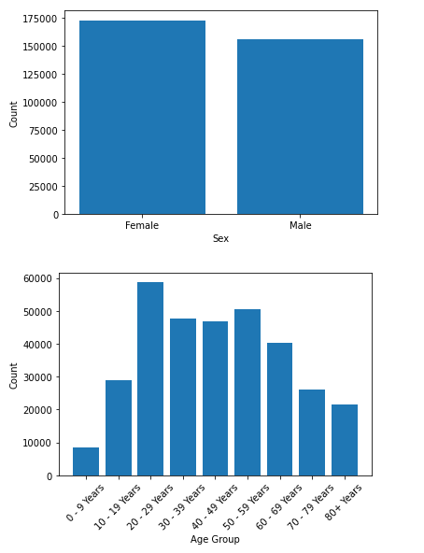
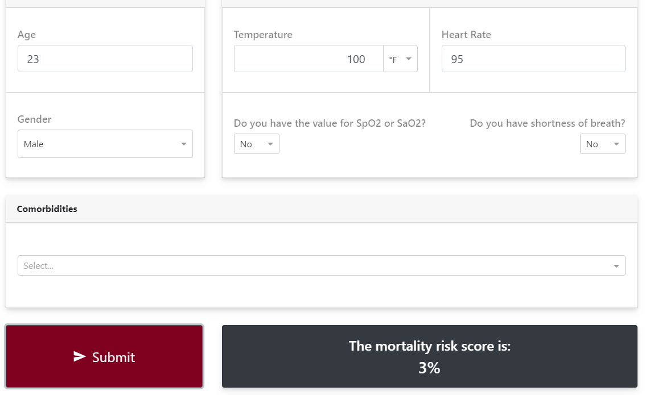
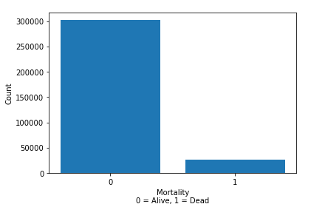
Introduction
Covid-19 Case Dataset from the CDC
We removed rows with missing and unknown values
What Raises Mortality Rate?
Mortality Calculator?
ethnicity, sex, med-condition, and age
Notes:
Covid 19, is what everyone is talking about recently. And our project is no different, we wanted to look at covid case demographics and how those factors would predict mortality in the patient.
We had found an interesting calculator that would give you a chance of death based on personal information. We were not able to get the dataset they used so we went with a large dataset that was available from the cdc. This dataset from the cdc is updated once a month and has a large number of the cases that has happened in the united states.
We first focused on exploring the data and looking at the distributions of each variable.We were focusing on cases that were lab-proven and not missing or unknown, so we removed rows with missing and unknown values, and we also removed ‘date’ data from the dataset. We were looking into how date was affecting mortality as a possible future work.
One problem with this dataset is does not have all of the personal information so finding out specific mortality rate with medical conditions was not availible, but ethnicity, sex, ‘having a medical condition’, and age were avalible. Two other interesting columns where is they were regularly hospitalized or if they were admitted to the ICU.
And we looked a few ways to model how features would predict mortality in a covid case. We looked at logistic regression, multi-layer perceptron classifier, linear regression, elastic net and ridge. We focused on two main models for predicting mortality rate, and I will pass it to nick with logistic regression.

Slide 4
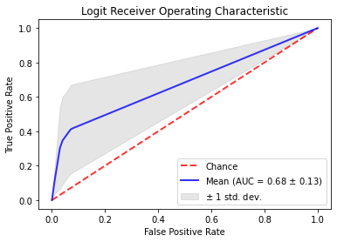
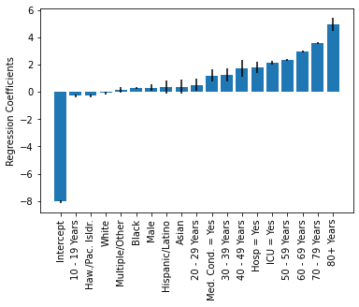
Logistic Regression
Probabilities calculated using logit model ⇒ dead if p >= 0.5
K=5 Folds, ~330,000 records
Key Classification Metrics:
F1 = 0.683 ± 0.132,
AUC = 0.676 ± 0.149
Odds of mortality changes:
0-9 yrs ⇒ 80+ years : 143
ICU? ⇒ 8.59
Hospitalized? ⇒ 6.21
Medical Condition? ⇒ 3.36
Race Comparisons
American Indian/Alaskan ⇒ Asian: 1.47
Female ⇒ Male: 1.39

Slide 5

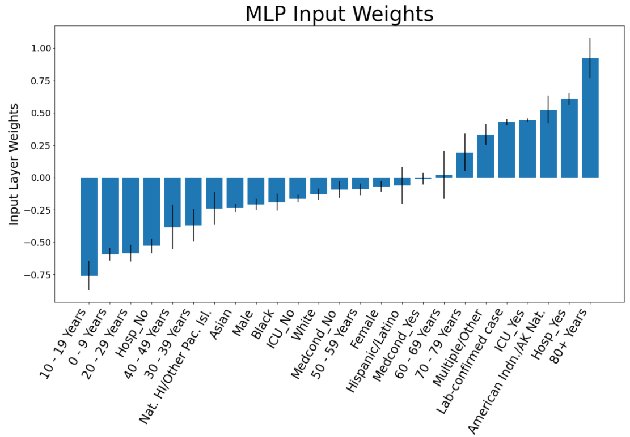
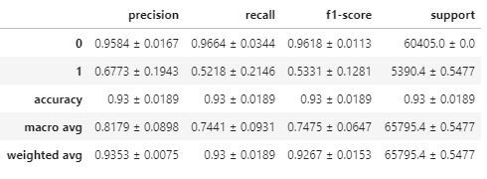

MLP Classifier
GridSearchCV used to find optimal parameters
Stratified K-Fold for Cross-Validation
Input Layer Weights for Feature Impact
Combined Confusion Matrix
0 1
Predicted Label

Slide 6
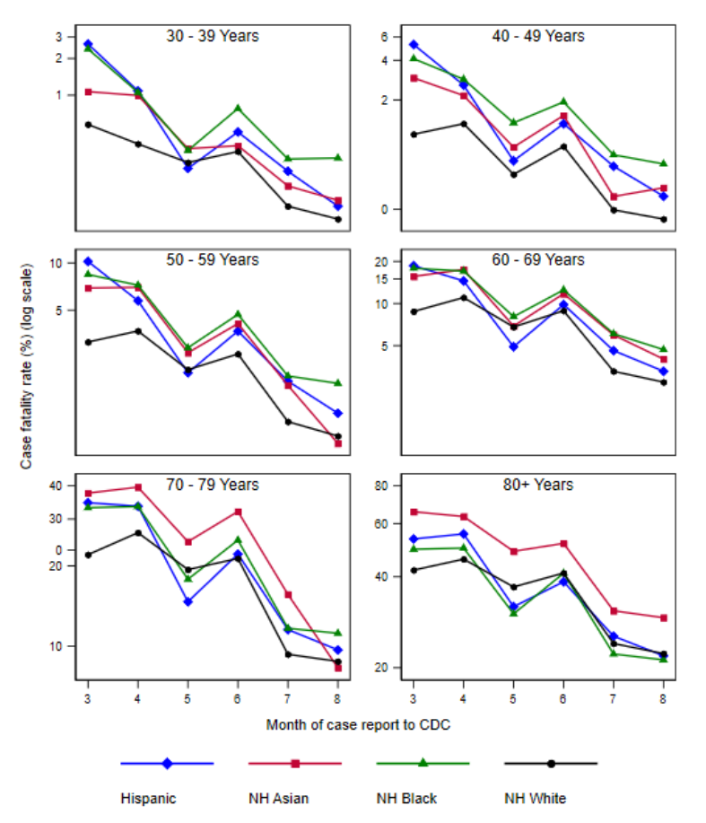
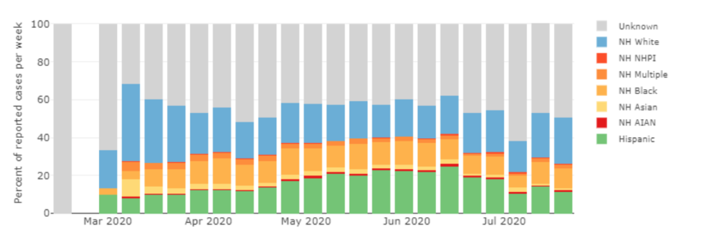
Background
Many articles also analyze the same dataset from CDC, results are mostly consistent with ours
80+ year old had highest case fatality
Contrary results to many studies for different ethinc groups
[1] Age adjusted data showing case fatality for certain age groups
[2] Distribution of Covid-19 cases in the U.S.

Slide 7
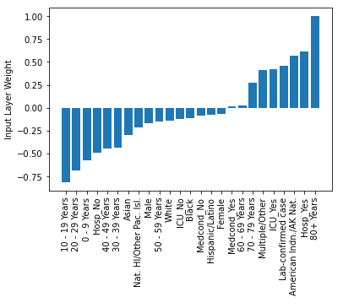
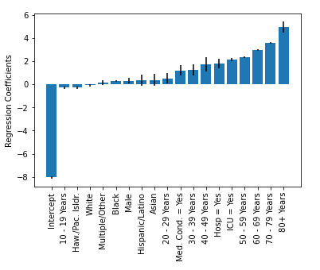
Conclusion
Case surveillance data from CDC was analyzed
Data sized from 1,048,576 to just 328,977 rows
Logistic regression and MLP Classifier considered but they didn't agree with every single feature
-Age is the biggest factor in for predicting low and high chance of death
-Another interesting find is that males have lower mortality than females in MLP model, but higher mortality in logit
- Being admitted to the hospital and ICU both increased your chances of dying.

Slide 8
Any
Questions?

Slide 9
References
[1] M. S. Fabic, Y. Choi, D. Bishai, “Deaths among COVID Cases in the United States: Racial and Ethnic Disparities Persist,” medRxiv, 2020.
[2] M. S. Fabic and Y. Choi, “Trends in age distribution of COVID-19 cases, hospitalizations, and deaths by race in the United States”, 13-Aug-2020. [Online]. Available: osf.io/preprints/socarxiv/7edgu.
[3] B. T. Rumain, M. Schneiderman, A. Geliebter, “Prevalence of Covid-19 in Adolescents and Youth Compared with Older Adults in States Experiencing Surges”, medRxiv, Oct. 2020.
[4] Centers for Disease Control and Prevention, "COVID-19 Case Surveillance Public Use DataCase Surveillance," 11 November 2020. [Online]. Available: https://data.cdc.gov/Case-Surveillance/COVID-19-Case-Surveillance-Public-Use-Data/vbim-akqf. [Accessed 16 November 2020].
[5] Statsmodels, [Online]. Available: https://www.statsmodels.org/stable/index.html. [Accessed 16 November 2020].
[6] scikit-learn, [Online]. Available: https://scikit-learn.org/stable/. [Accessed 16 November 2020].
[7] A. Patricio, R. S. Costa and R. Henriques, "COVID-19 in Portugal: predictability of hospitalization, ICU and respiratory-assistance needs," COVID-19 SARS-CoV-2 preprints from medRxiv and bioRxiv, vol. Preprint, pp. https://www.medrxiv.org/content/10.1101/2020.09.29.20203141v1.article-info, 2020
[8] A. S. Yadaw, Y.-c. Li, S. Bose, R. Iyengar, S. Bunyavanich and S. Pandey, "Clinical features of COVID-19 mortality: development and validation of a clinical prediction model," Lancet Digital Health, vol. 2, p. e516–25, 2020.
[9] Noam Barda, Dan Riesel, Amichay Akriv, et al., "Developing a COVID-19 mortality risk prediction model when individual-level data are not available," Nature Communications, Vols. 11, no. 4439, 2020.
[10] R. Bhatia, J. Klausner, “Estimating individual risks of COVID-19-associated hospitalization and death using publicly available data”, Cold Spring harbor Laboratory Press, 2020.

